Slide 1
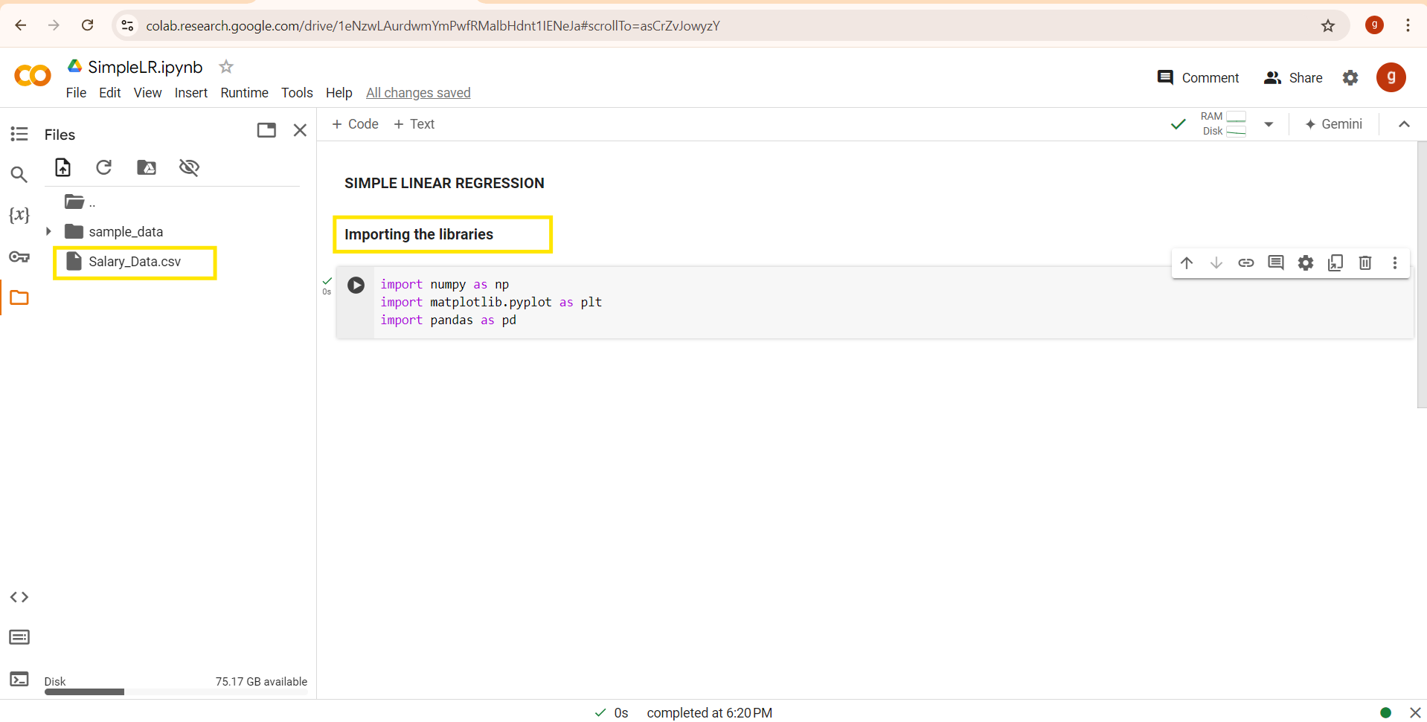
Import the libraries
Upload salary CSV file
From your system

Slide 2
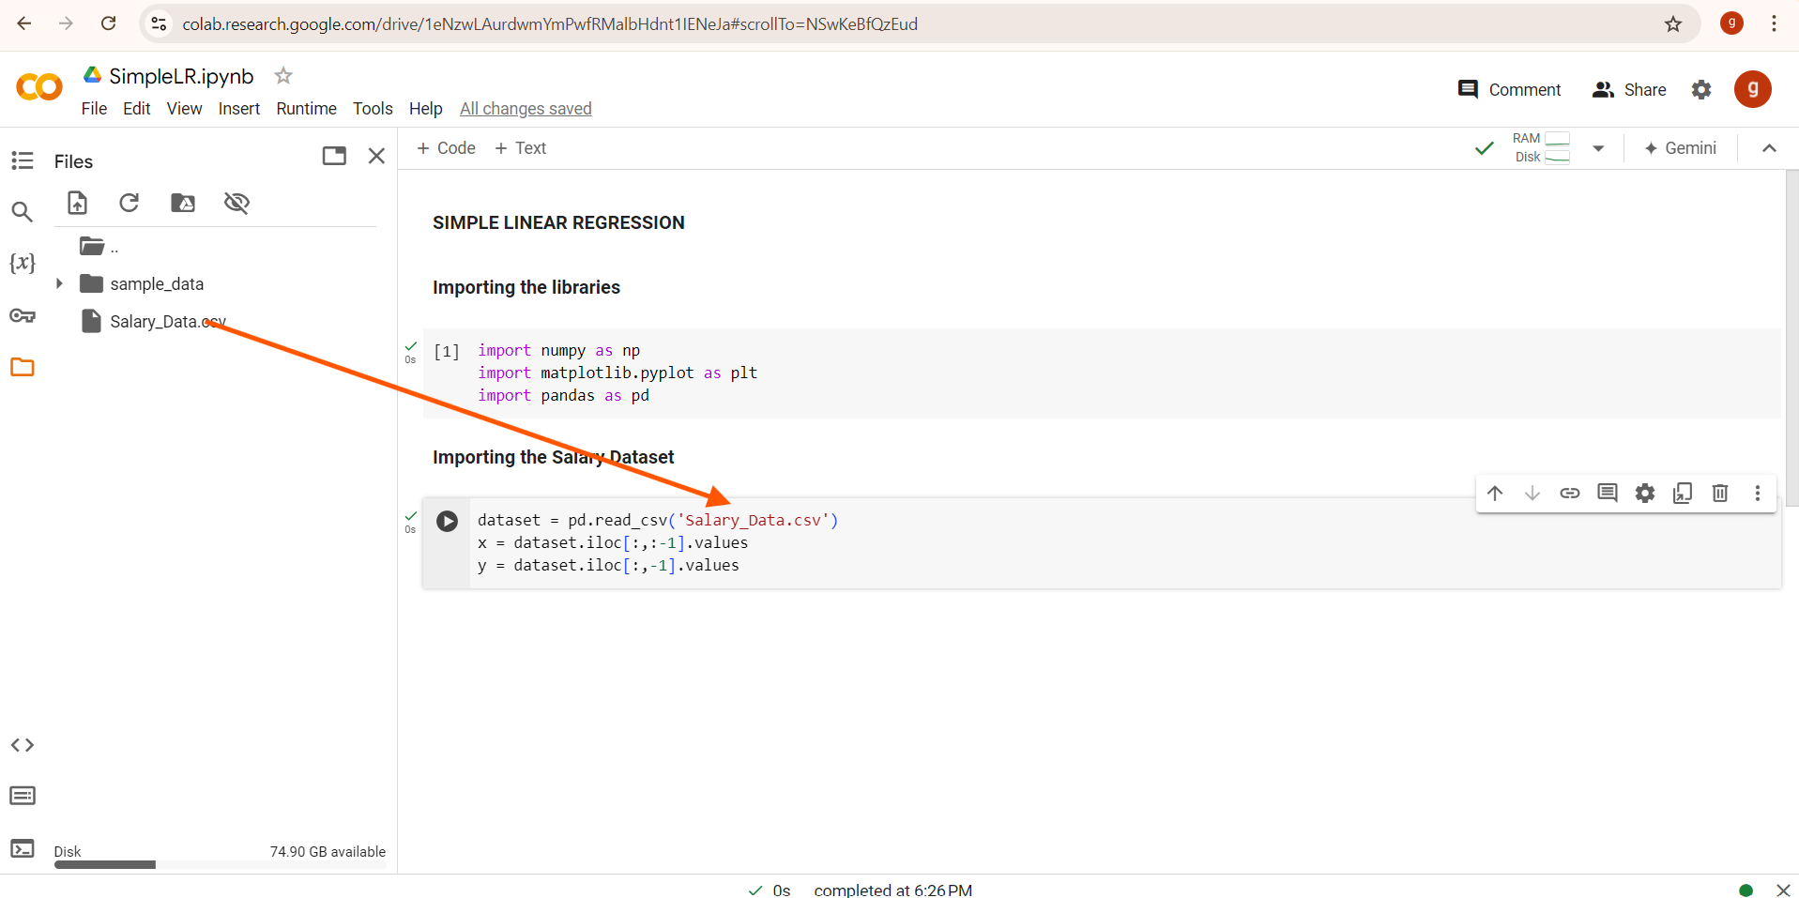
.values returns a 2D NumPy array, which is what scikit-learn expects.
# Already 2D → shape (rows, columns-1)
# 1D → shape (rows,)
dataset → Our Pandas DataFrame
iloc → integer-location based indexing
: → all rows
:-1 → all columns except the last
-1 -> The last column alone
.values → converts the result to a NumPy array

Slide 3
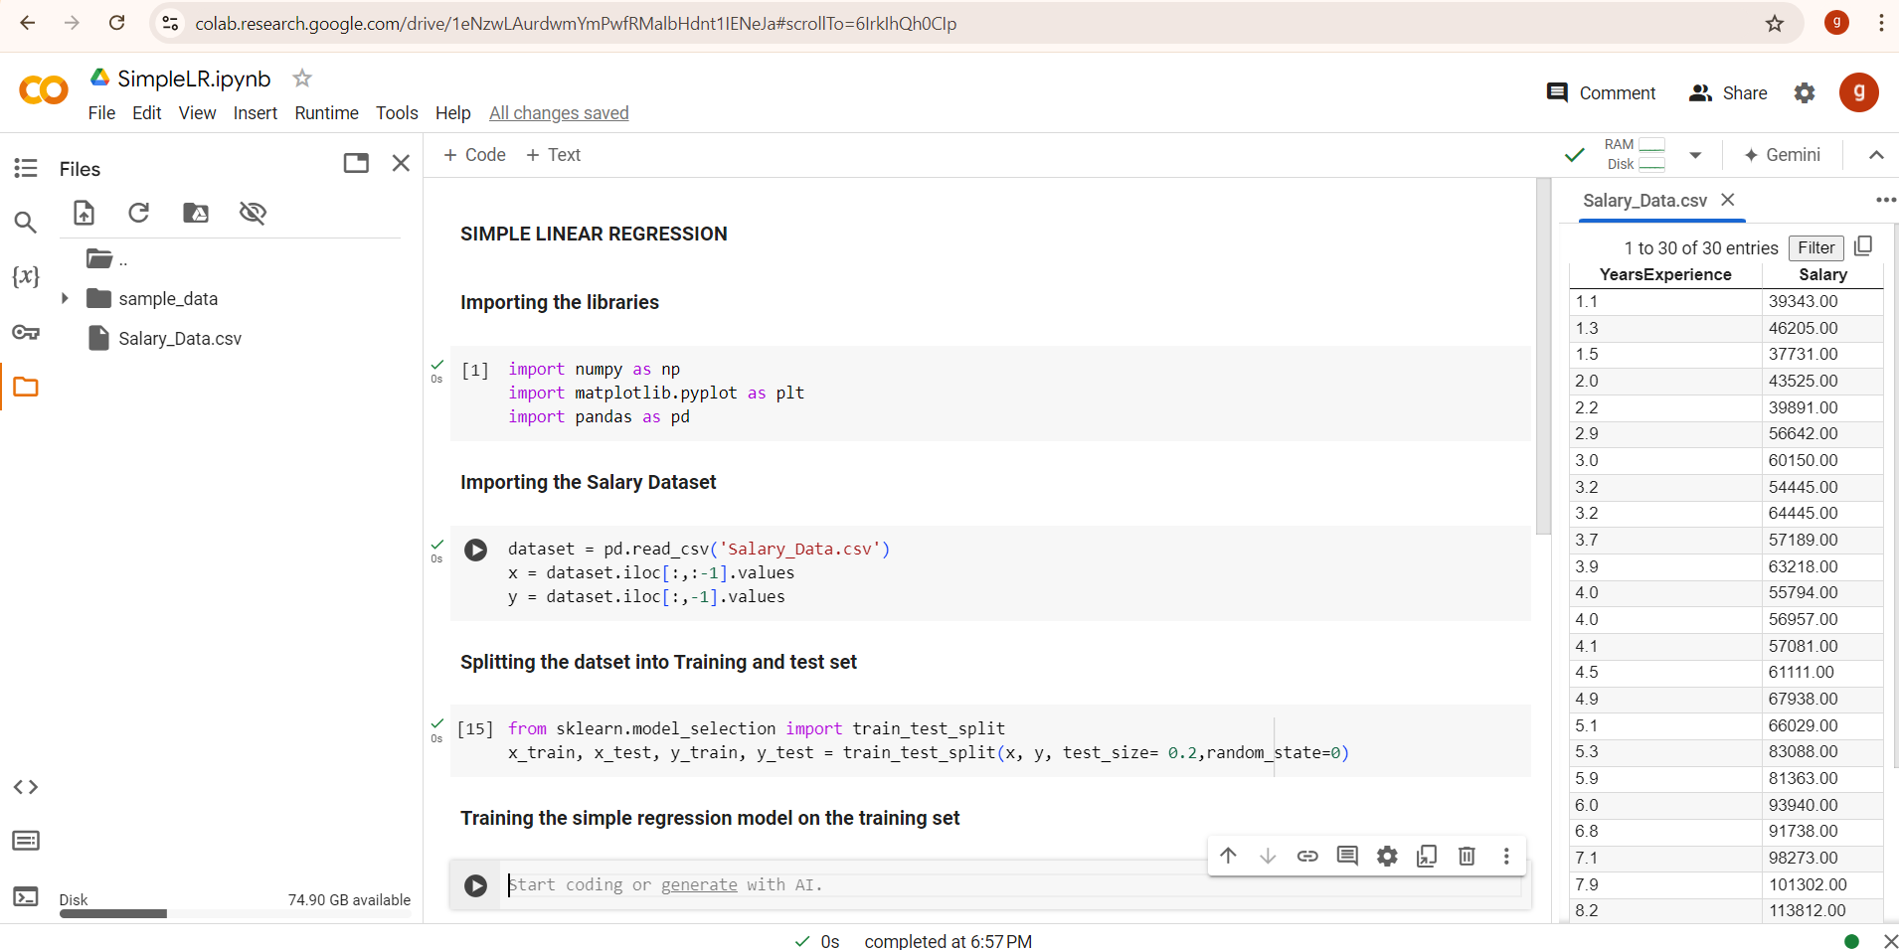
Train and test data split

Slide 4
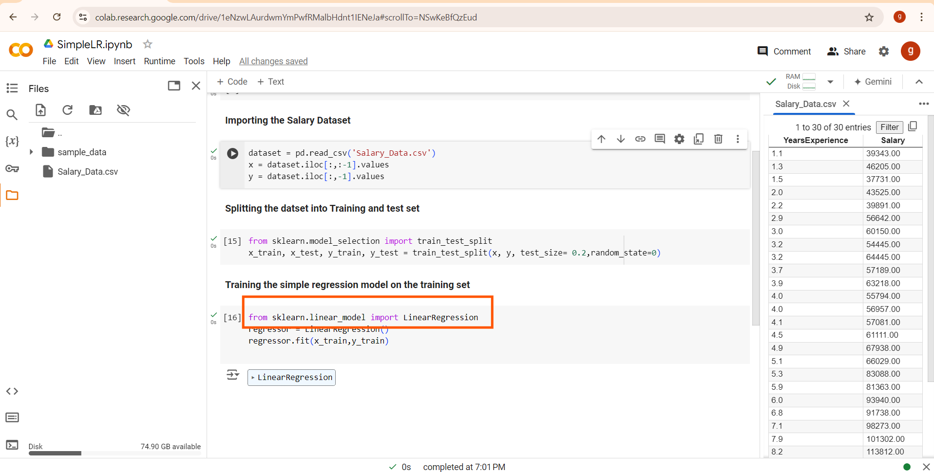
This line imports the LinearRegression class from the sklearn.linear_model module, which provides functionality for performing linear regression.

Slide 5
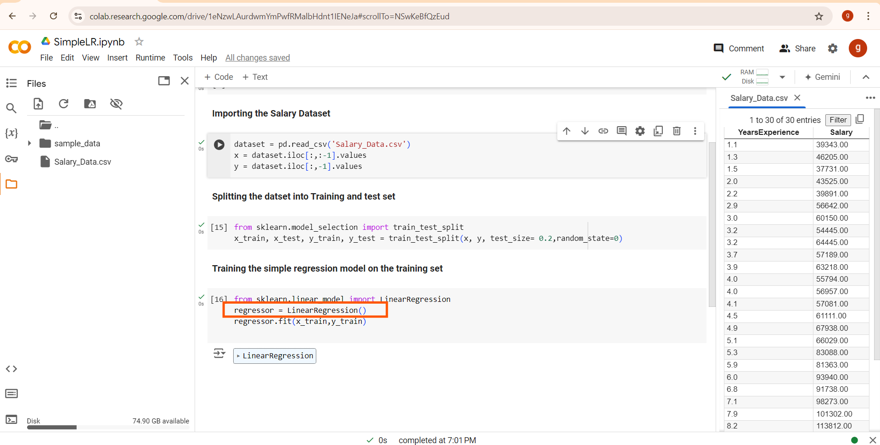
Here, you're creating an instance of the LinearRegression class and storing it in the variable regressor.

Slide 6
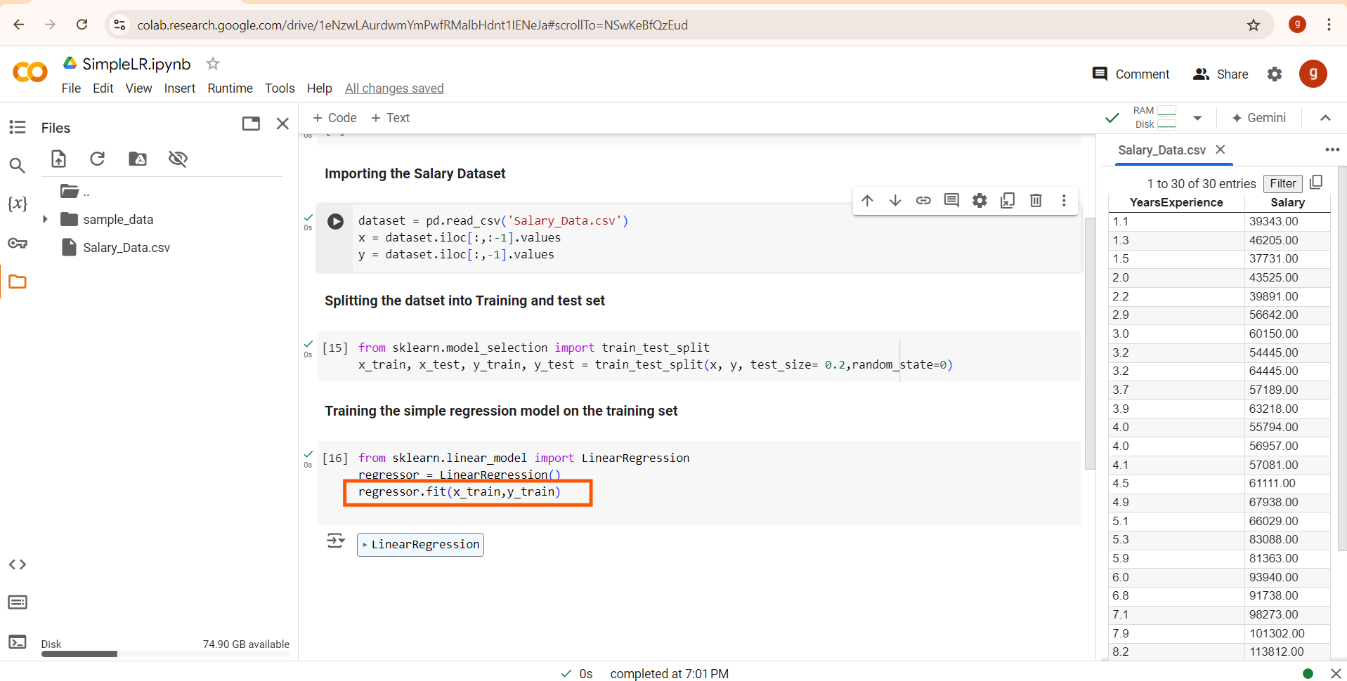
The fit method is used to train the linear regression model on the training data (x_train and y_train).
This instance (regressor) represents the linear regression model
The fit method calculates the optimal values for the model's parameters (slope and intercept) based on the training data.

Slide 7
LinearRegression() creates the model.
fit(x_train, y_train) trains the model on the provided training data, allowing it to learn the relationship between the input features (x_train) and the target variable (y_train).

Slide 8
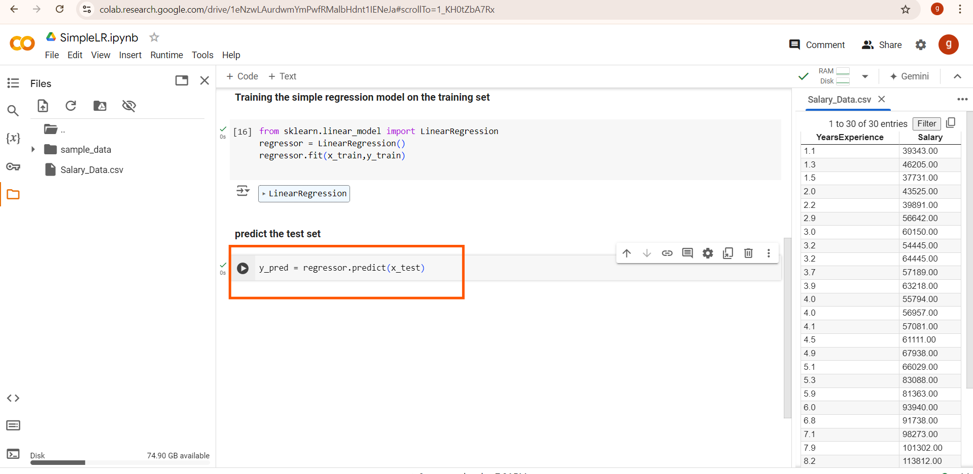
regressor.predict(x_test) uses the trained linear regression model (regressor) to predict the target values for the input features provided in x_test.
The predicted values are stored in the variable y_pred.
You can then compare y_pred with the actual values (y_test) to evaluate the performance of your model.

Slide 9
What Happens During predict?
The model applies the learned linear relationship (slope and intercept) from the training phase to each sample in x_test to predict the corresponding y values.
For each feature value in x_test, the model calculates the predicted output using the equation of the line (in case of simple linear regression):
predicted 𝑦=intercept+(slope×𝑥)

Slide 10
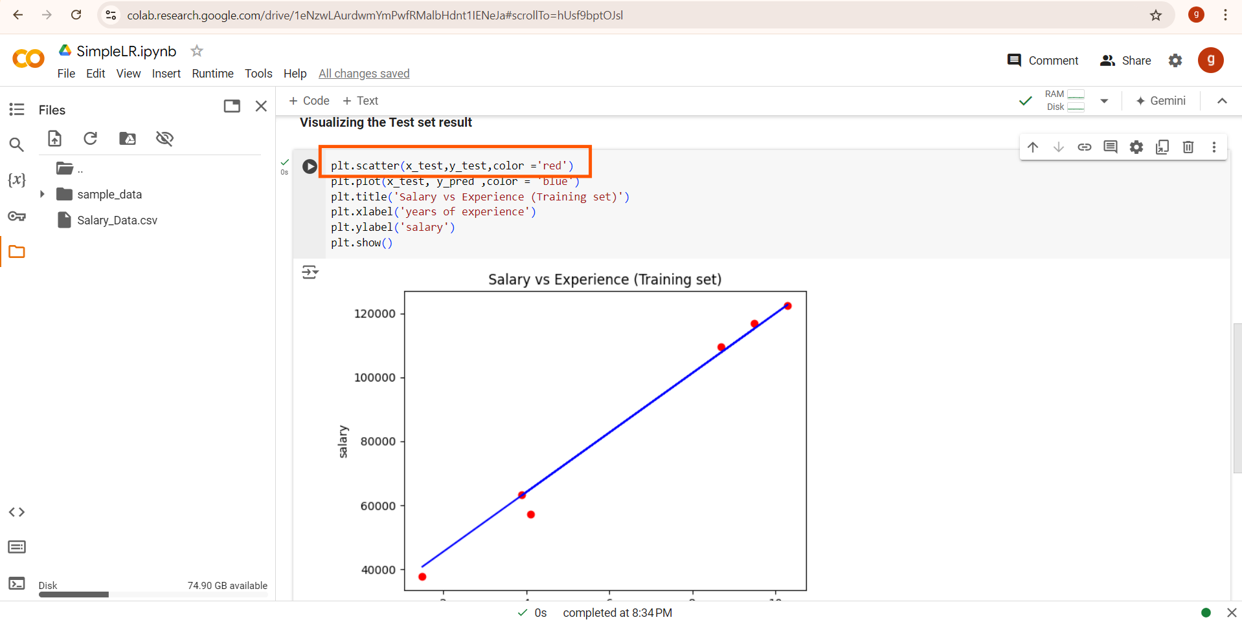
plt.scatter creates a scatter plot.
x_test is plotted on the x-axis (years of experience).
y_test is plotted on the y-axis ( salary).
This red color plots visualizes the actual data points from the test set, showing the real relationship between years of experience and salary.

Slide 11
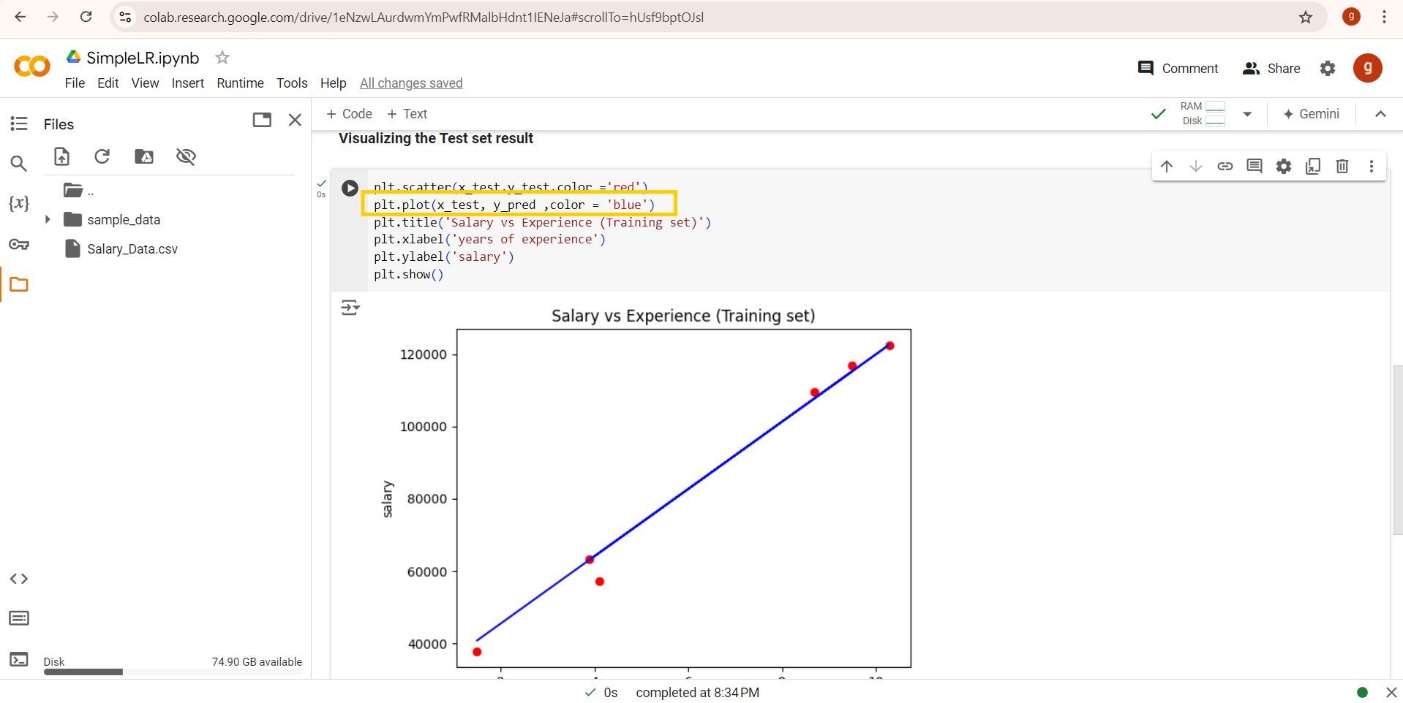
plt.plot is used to plot a line.
x_test is plotted on the x-axis.
y_pred is plotted on the y-axis.
y_pred contains the predicted salary values for the corresponding x_test values, generated by the model using regressor.predict(x_test).

Slide 12
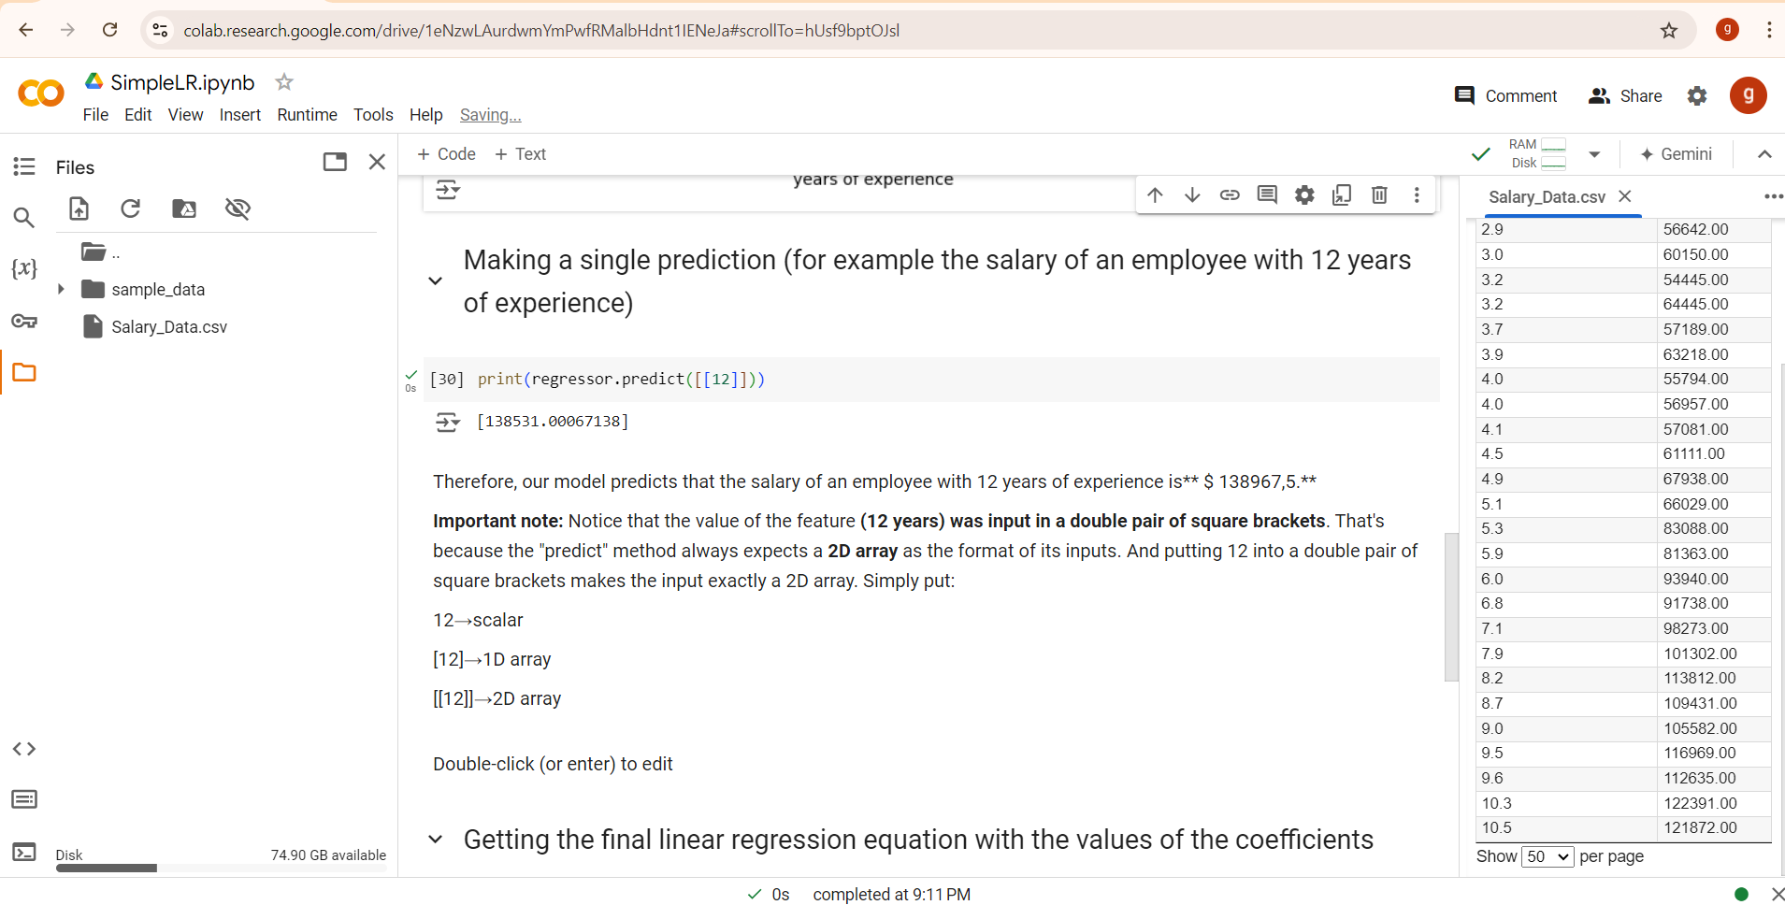

Slide 13
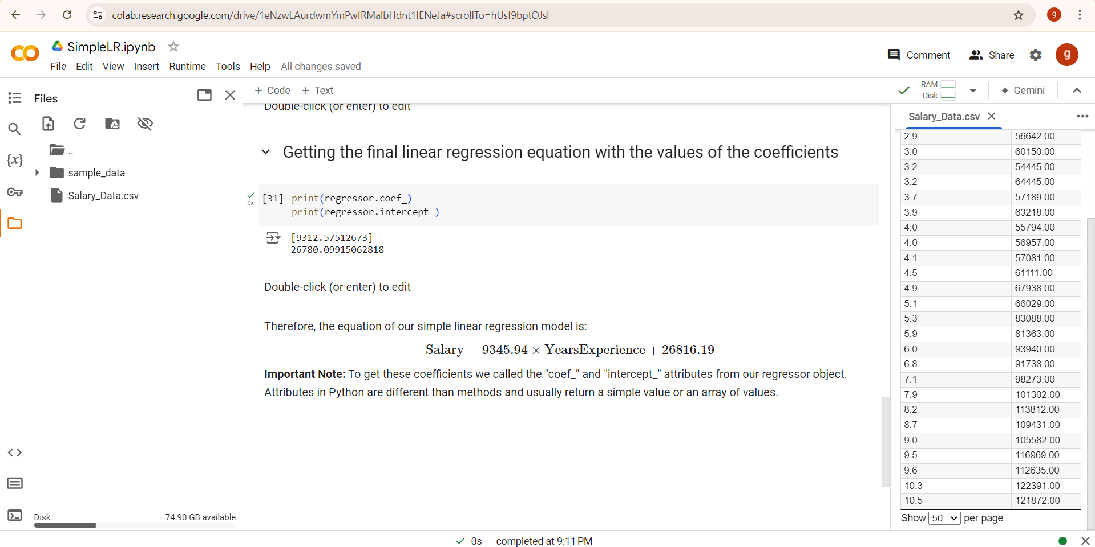
Intercept: 26780.0091506means that if a person has 0 years of experience, the predicted starting salary (based on this model) would be approximately $26816.
Coefficient: 9345.94 suggests that for every additional year of experience ,the model predicts an increase in salary by $935.94, assuming a linear relationship.

Slide 14
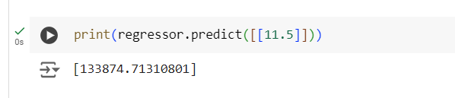
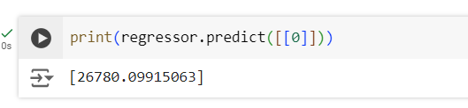
Prediction for 11.5 years
Prediction for 0 years of experience

